Slide 1
Explainable AI LIME

Slide 2
Explainable AI (XAI)
Explainable AI (XAI) helps explain a AI model’s decision-making process
Some of the most famous XAI techniques include SHAP (Shapley Additive exPlanations), DeepSHAP, DeepLIFT, CXplain, and LIME
Explainable AI methods, such as LIME, allow to explain and interpret the predictions of machine learning models
Interpretability means understanding why certain predictions are made by a model. Knowing these reasons increases the acceptance of and confidence in machine learning models
A ML model predicts with 70% accuracy that a patient has lung cancer. Though the model might have given the correct diagnosis, a doctor can’t really advise a patient confidently as he/she doesn’t know the reasoning behind the said model’s diagnosis

Slide 3
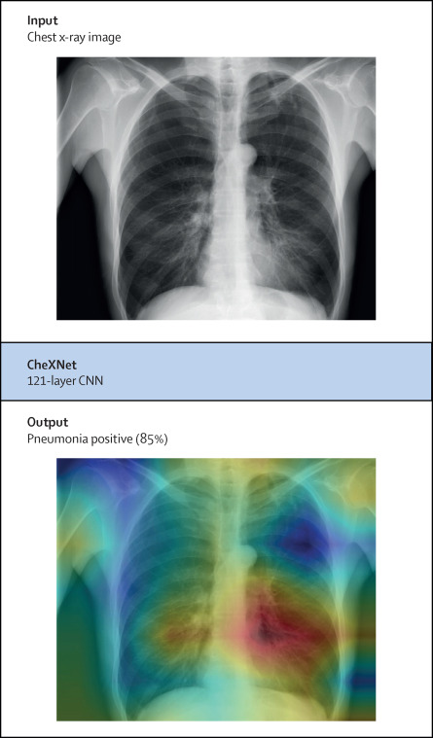
Explainable AI (XAI)
XAI can then help in medicine to detect disease using images.
Explainable Artificial Intelligence (XAI) tools quickly and easily highlight the areas in images that are crucial for classification, thus providing the attending doctor with significant support in making decisions

Slide 4
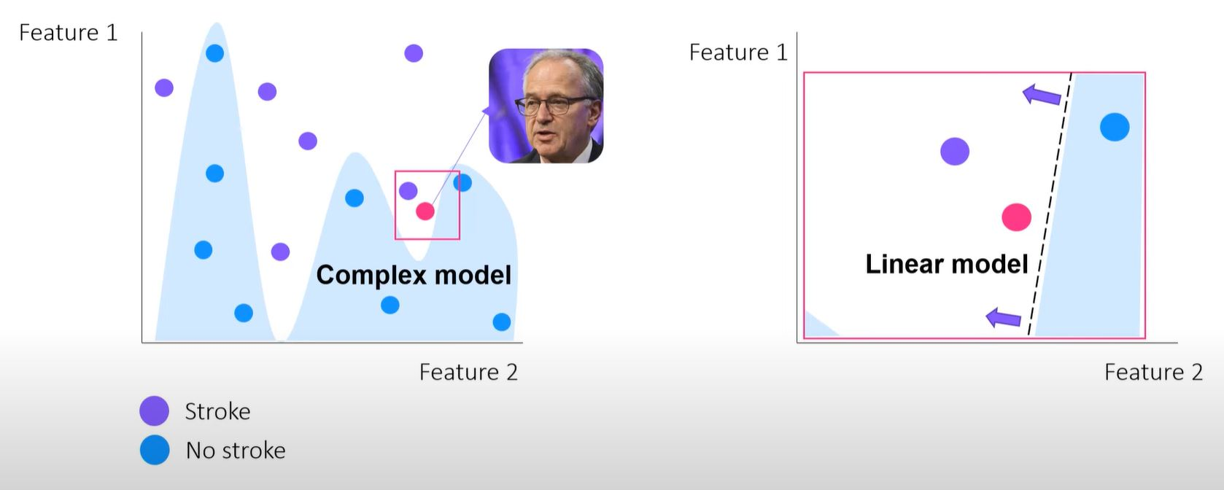
LIME XAI
Local Interpretable Model-agnostic Explanations (LIME)
Model agnosticism refers to the property of LIME using which it can give explanations for any given supervised learning model
Local explanations mean that LIME gives explanations that are locally faithful within the surroundings of the observation/sample being explained
LIME gives a local interpretable simpler linear surrogate model into the local area of a complex model

Slide 5
LIME XAI
Local Interpretable Model-agnostic Explanations (LIME)
Model agnosticism refers to the property of LIME using which it can give explanations for any given supervised learning model
Local explanations mean that LIME gives explanations that are locally faithful within the surroundings of the observation/sample being explained
LIME gives a local interpretable simpler linear surrogate model into the local area of a complex model
The method explains the
classifier for a specific single
instance and is therefore
suitable for local explanation

Slide 6
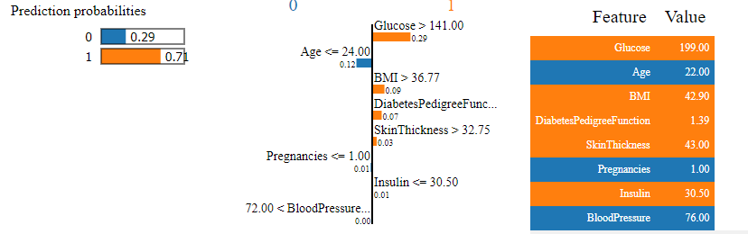
LIME XAI
LIME provides locally faithful explanations around the neighborhood of the instance being explained. By default, it considers 5000 samples(num_samples). Then it obtains the target variable for these 5000 samples using the prediction model, whose decisions it’s trying to explain.
Feature Selection from the surrogate dataset: After obtaining the surrogate dataset, it weighs each row according to how close they are to the original sample/observation. Then it uses a feature selection technique to obtain the top important features (Feature 2).
LIME also employs a Ridge Regression model on the samples using only the obtained features

